Slide 1


Final Project - Phe Phase A
Hadar Iluz & Matan Ben Hayon

Slide 2



Roadmap
Introduction
Our Solution
Verification
Motivation
Preliminary Research
The Product
Challenges
1

Slide 3

The Motivation
Ecological problem: People would rather throw away products they don't need than finding someone who needs them.
Reliability: There is no reliability in second-hand products.
Accessibility: Outdated and inconvenient technologies.
It is difficult to find a product in conditions that suit the customer, such as close location.
2

Slide 4
Introduction
The site 'Altizachen' contains all the solutions for the same problems we mentioned earlier - Ecological, reliable and accessible.
A site that connects a product to new owners, and so protecting the environment and creating a new culture - Consumption of second hand products.
We focus on 3 things that emerged from our preliminary research:
Location- filters products by location.
User friendly UI- menu that is easy to use.
Reliability- create a user ranking based system.
3

Slide 5
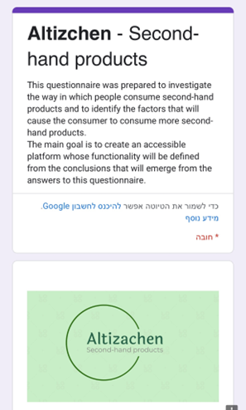
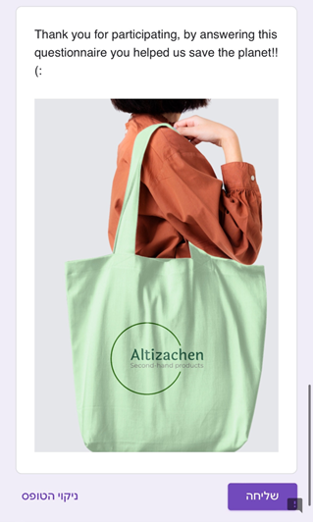


Preliminary Research
Link to 'Altizachen' questionnaire
Distributed in:
Facebook groups for second hand products.
Colleagues, friends and students.
4
send

Slide 6
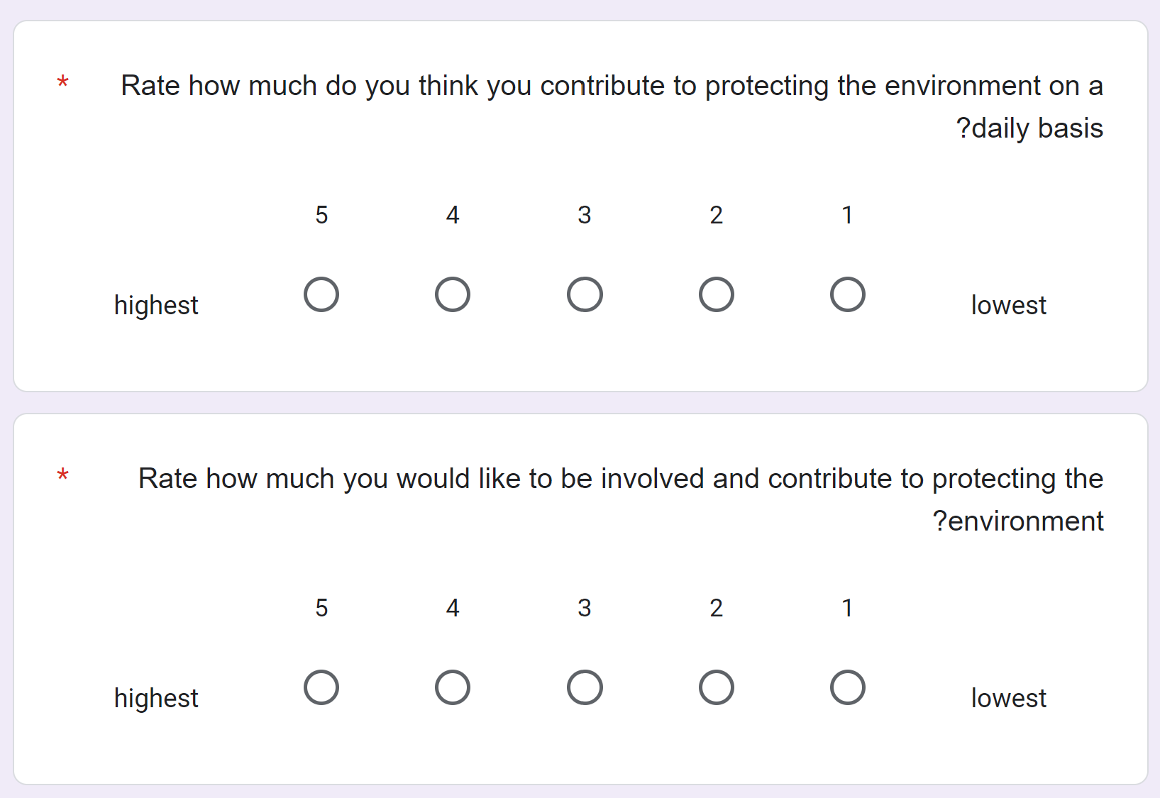
Preliminary Research
1+2
Most of the people reported that they would like to help to protect the environment and change the consumption culture, but in practice they don`t do it.
5

Slide 7
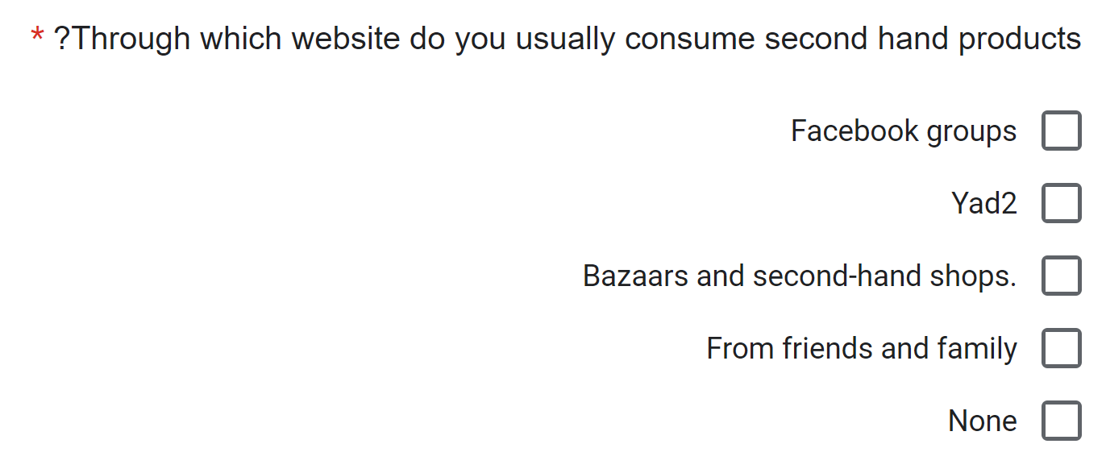

Preliminary Research
3
Many people tend to consume second-hand products in:
second-hand stores
Facebook groups
YAD2 website.
6

Slide 8
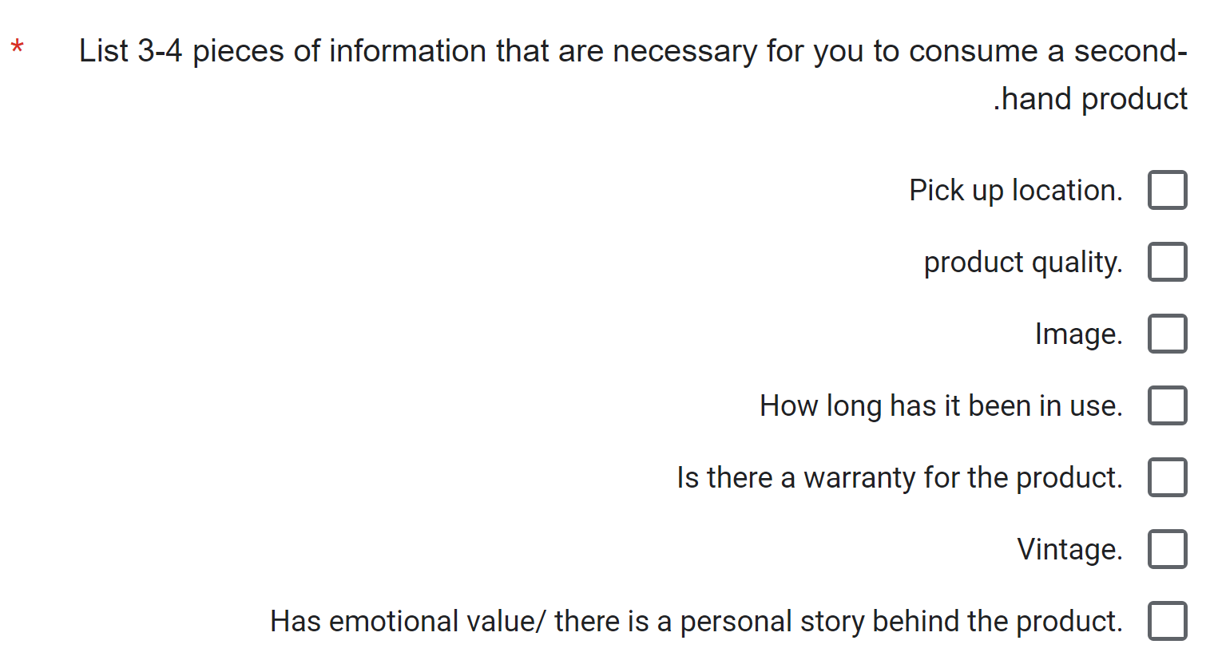
Preliminary Research
4
The most important criteria for each ad need to include:
location
Image
product quality
7

Slide 9
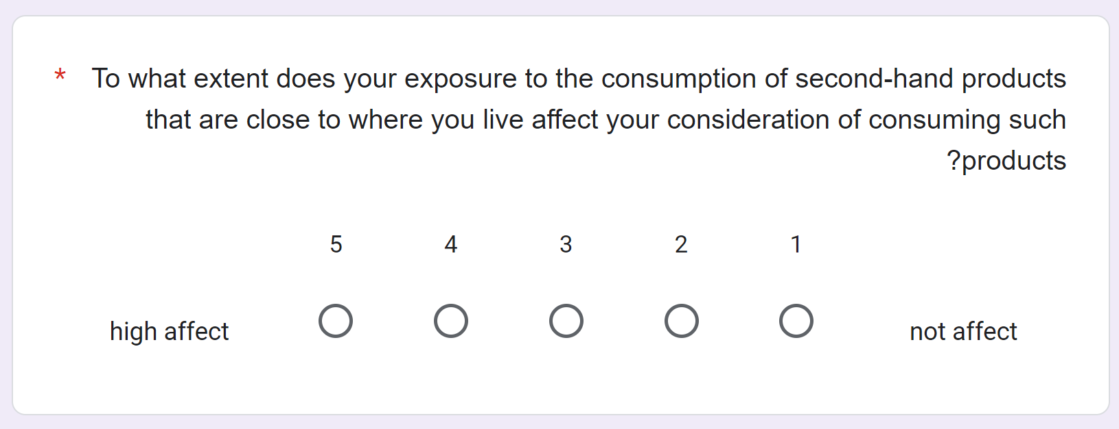
Preliminary Research
5
Indicating that presenting products that are closer to the user geographically will significantly increase the chance that the user will want to consume second-hand products.
8

Slide 10
Our Solution
Using Google Map API to direct and present to the user the closest products to him.
Location
Rewarding the donors who contributed successful products with good and fair service by a rating service.
Rating Donors
Classify Ads
Ability to classify smart categories to get to the relevant ads quickly.
Details
Display full information on each product.
9

Slide 11
Our Solution
'Altizachen'- a site for donating second-hand products, contain unique elements like:
The ads are displayed according to the user's location.
Helps to sustain the environment for future generations.
Requires mandatory fields to be filled in before publishing any ad.
Allow people find unique items that they search.
10

Slide 12
Our Solution
Each ad will be deleted after X days-
Maintains relevance.
Marketing strategy.
Prevent servers overload.
11

Slide 13
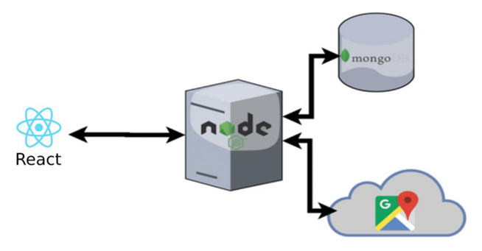
The Product
MongoDB
Node.js is
React
Google Maps API
Dijkstra’s Algorithm
12

Slide 14
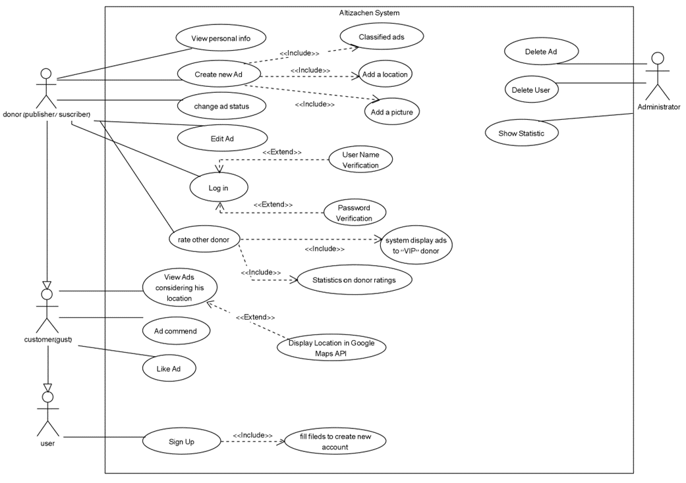
Use case diagram
13

Slide 15
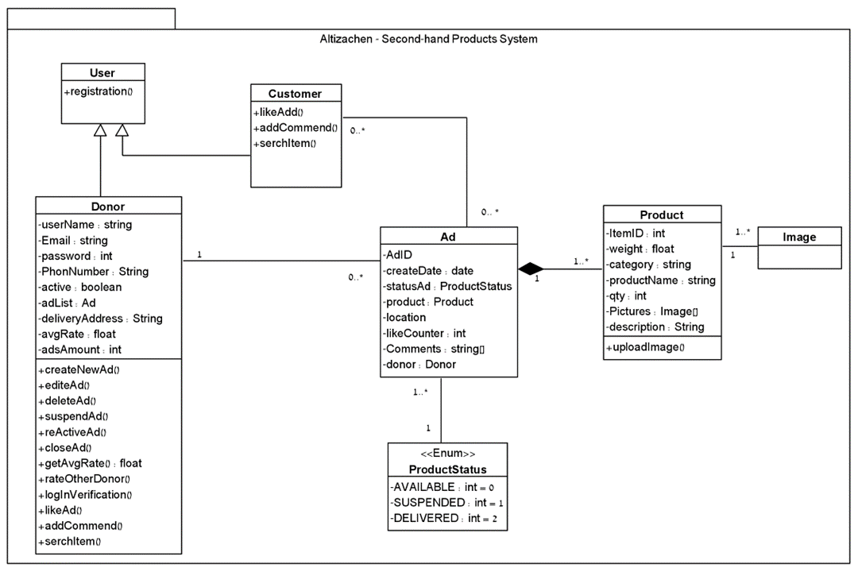
Class diagram
14

Slide 16
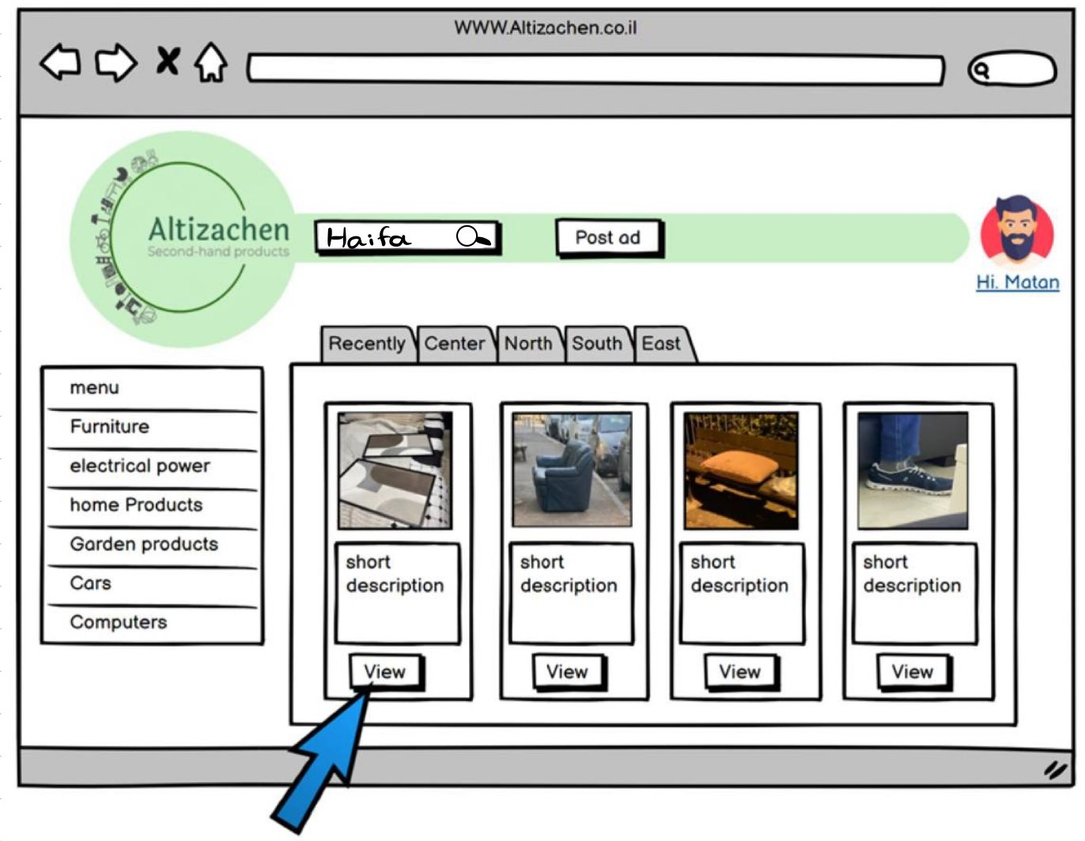
The Website- Home page
15

Slide 17
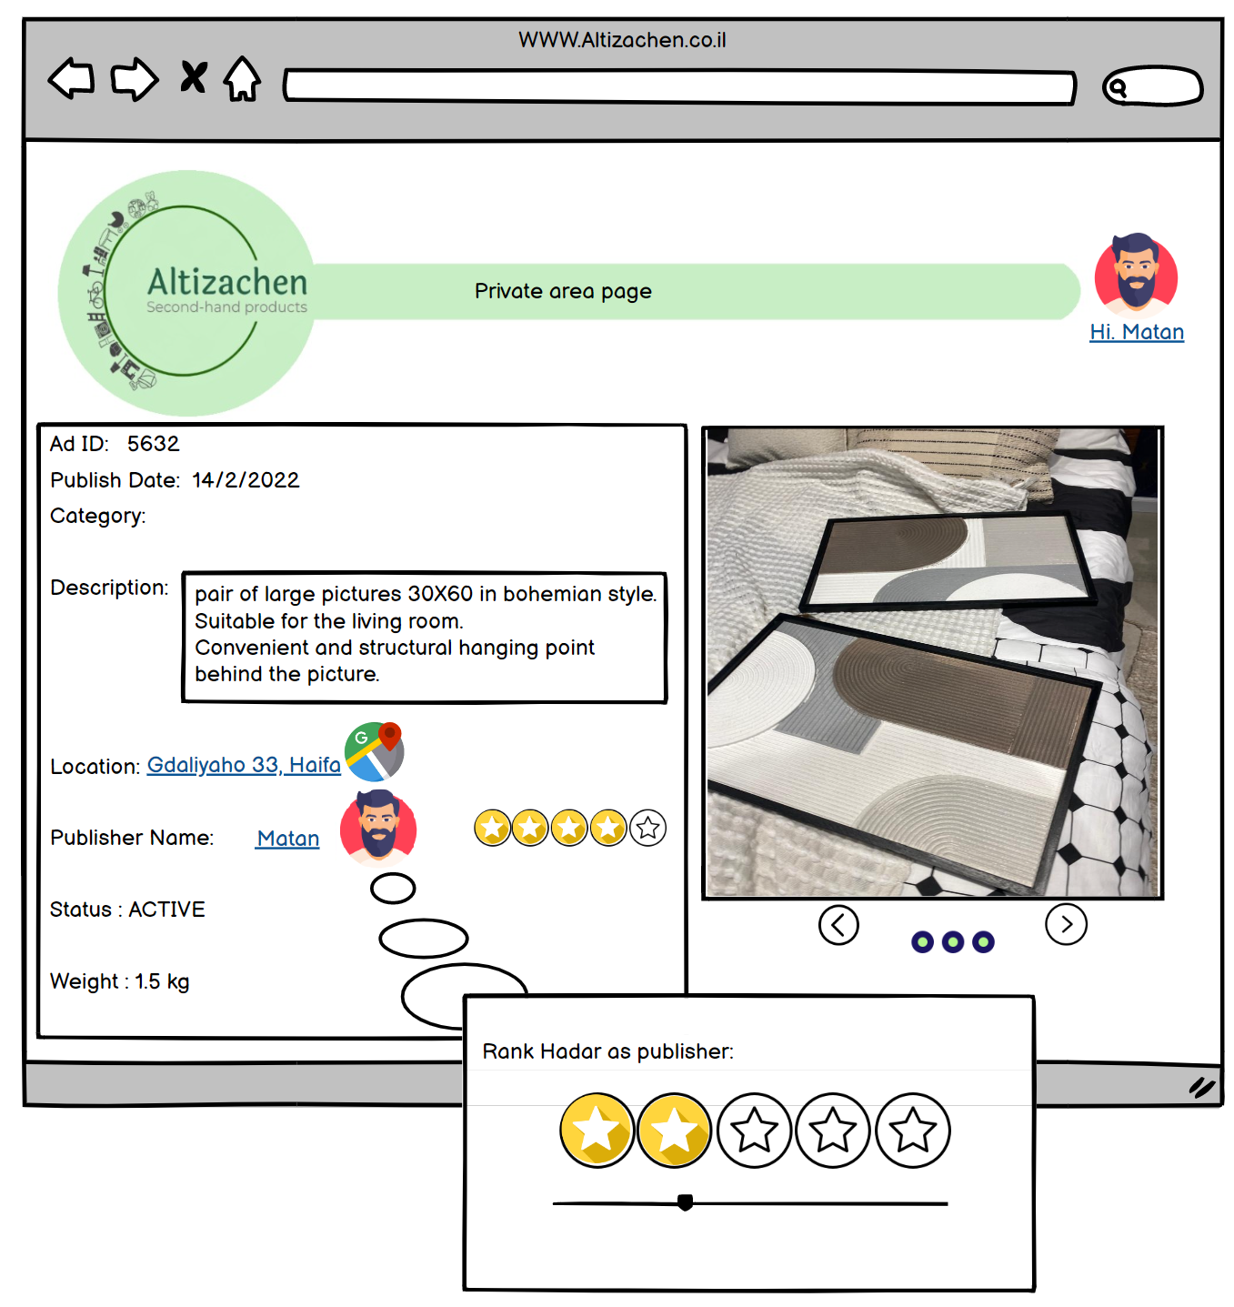
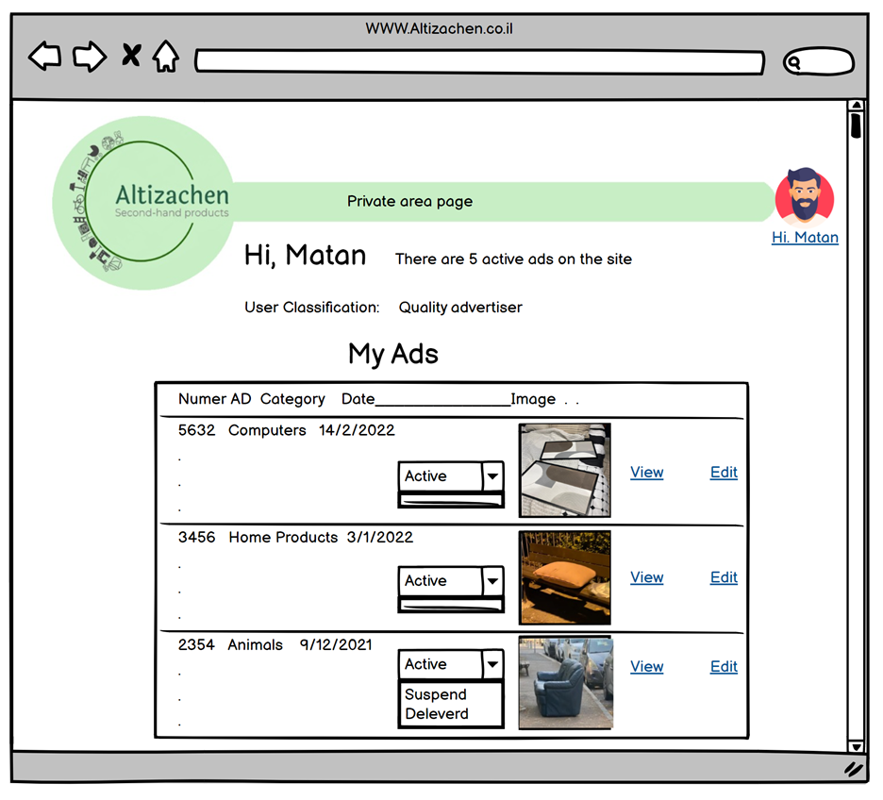
The Website
16

Slide 18
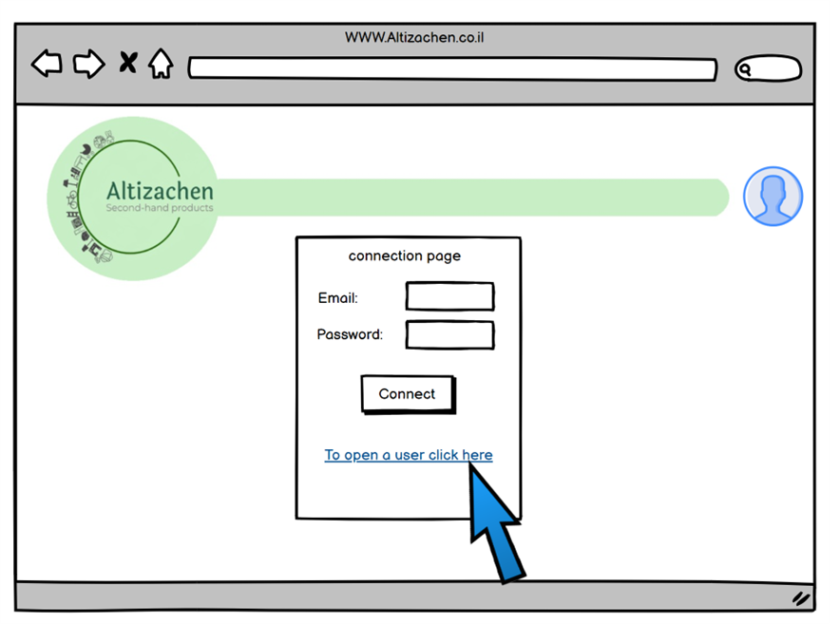
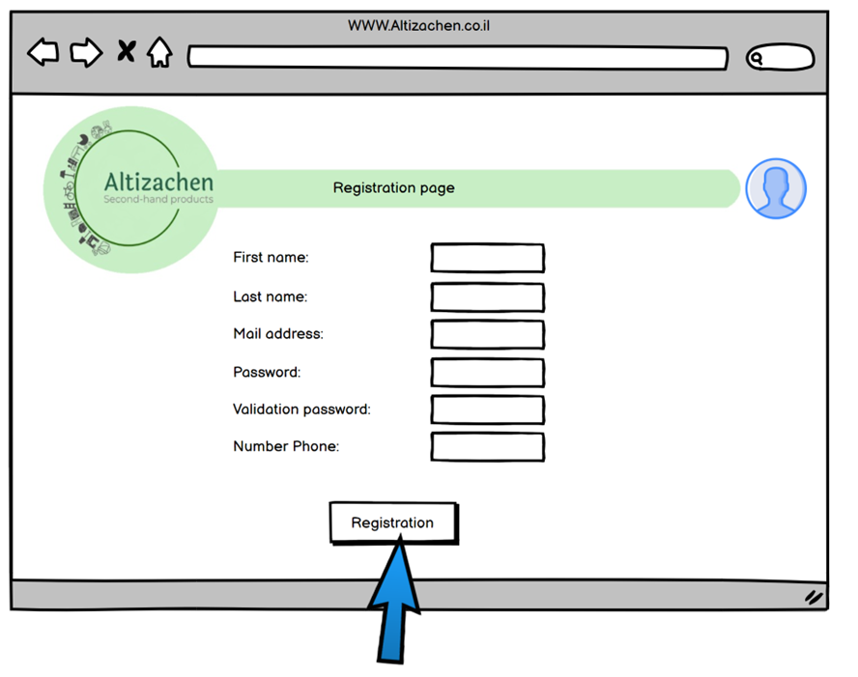
The Website- Login and registration
17

Slide 19
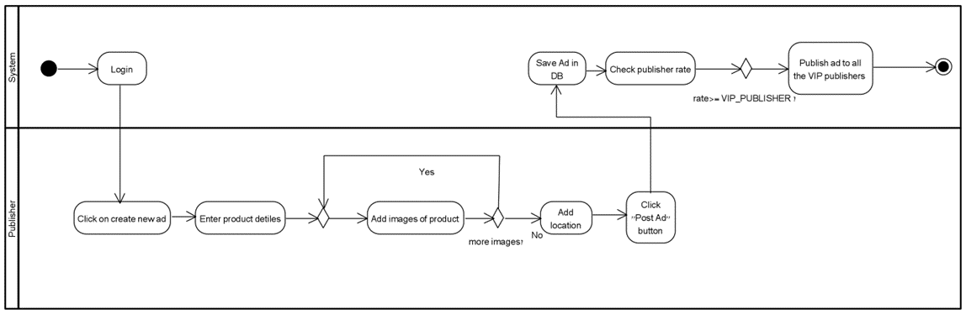
Activity Diagram- Create New Ad
18

Slide 20
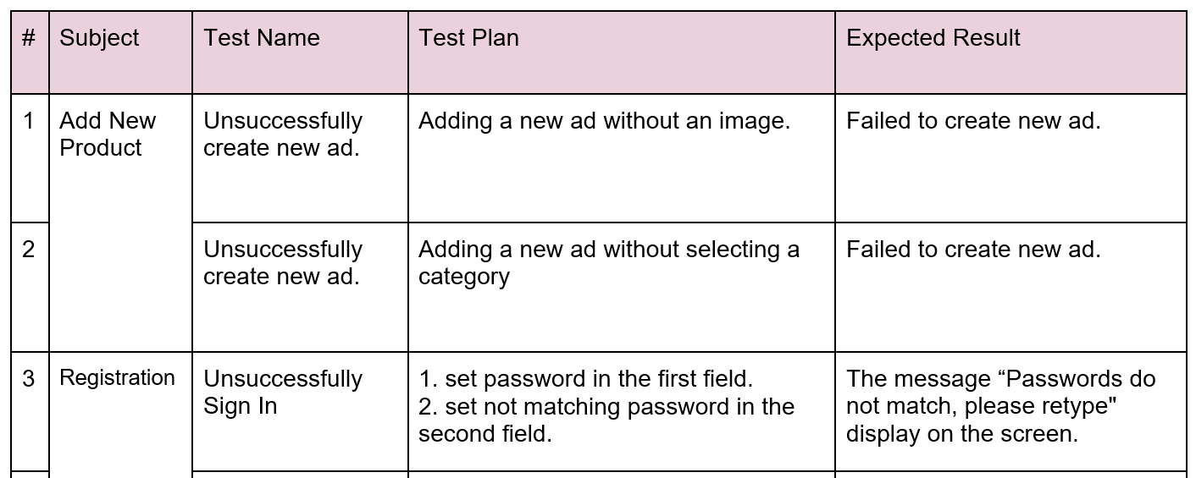
Verification- Unit Tests
19

Slide 21
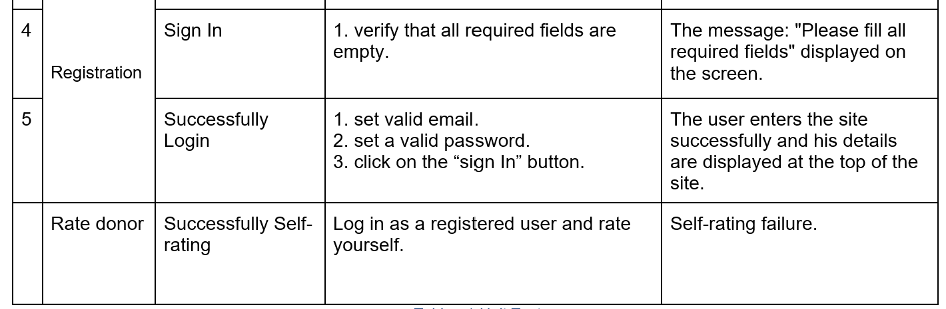
Unit Tests
20

Slide 22
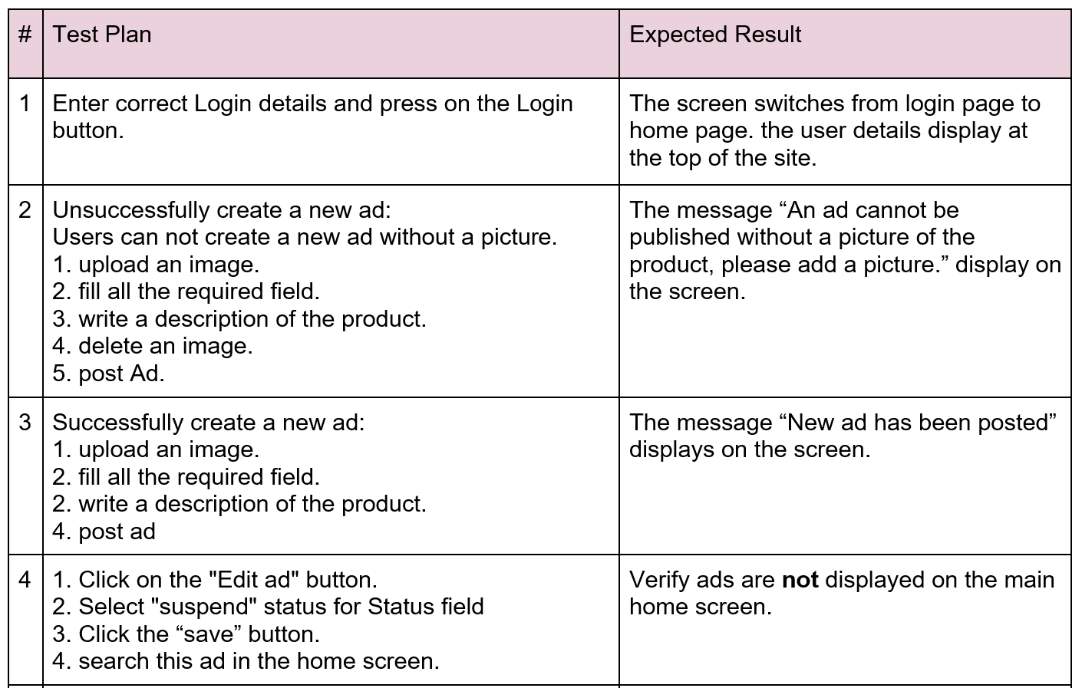
Verification- Functionality testing
21

Slide 23
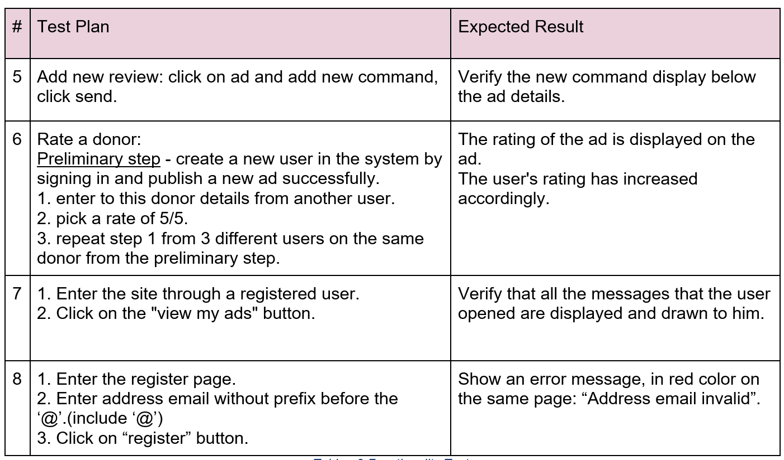
Functionality testing
22

Slide 24
Challenges
Work with new languages and technologies - Frontend and Backend.
Create an interface that will provide good user experience and create an easy to use interface.
Working on the project during the semester.
23

Slide 25
Thank
you!

Slide 26



Any Questions?

